Slide 1
RAE INC.
By -Romell Segeran
-Akshay Singh
-Eric John

Slide 2
Project Description
In most developed countries, heart disease is the leading cause of death. Because of plaque buildup, the heart's beating motion is disrupted. Such patients with heart conditions need constant attention for help in case of a heart attack or cardiac arrest
Doctors and Nurses need to attend many other patients in the Hospital, hence it becomes difficult for them to give constant attention to one patient alone, at the same time the medical response time to the patient, who needs urgent help, would be delayed.
The purpose of this project is to eliminate the need for constant attention for the patient by the Doctor and the Nurse and to reduce the amount of medical response time as much as possible.

Slide 3
OBJECT MODEL DIAGRAM

Slide 4
Special Features
The sensor is an IOT device which is carried by a person that tracks the vital signs such as heart rate, blood pressure and pulse. In case if the vital signs go abnormal immediately the persons relatives, ambulances and hospitals are informed.
Communication takes place through an email to handle about a patient emergency to the relative.
Mutual access to the individual work areas of patient, doctor, nurse, ambulance etc. with each of them having different work areas.
A chart is being displayed to graphically display the vital signs of a patient.
The location using the sensor is simulated and thus the latitude and longitude of the sensor is found using its IP address.
Implemented captcha in the login screen for added security.
Used predictive model for analysis of medicine assigned to patients.
Introduced an algorithm to calculate the distance between ambulance and patient through IP address.

Slide 5
Actors and Use Cases
System Administrator- An administrator responsible for managing all the upper level user accounts.
Enterprise Admin-Responsible for creating multiple organizations such as nurse, patient, ambulance, doctor. Multiple user accounts are created by enterprise admin and at the same time manages all the employees.
Doctor- Gets the emergency request from patient and processes the request.
Lab-Lab admin gets lab work request from the patient.
Patient- Patient can check his vital signs and send lab test request to the lab assistant.
Ambulance-Receives emergency request from the sensor if the vital sign of the patient is abnormal.
Distributor Administrator-Creates provider organization in distributor enterprise.

Slide 6
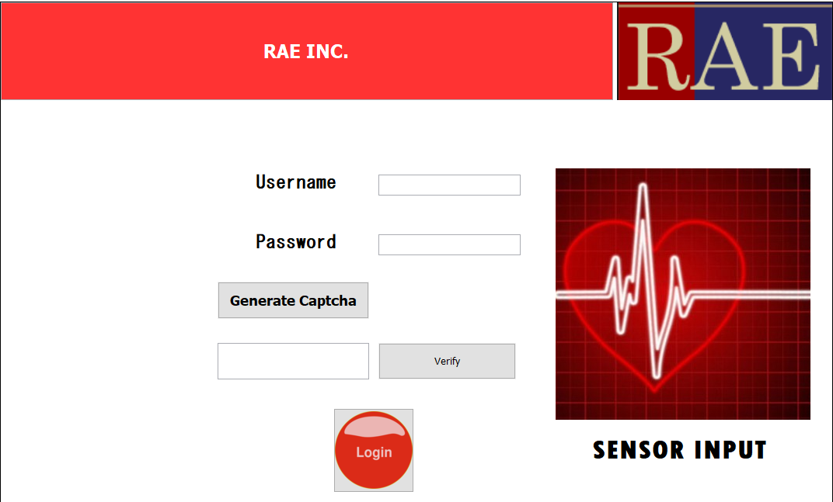
Screenshots
Login Screen

Slide 7
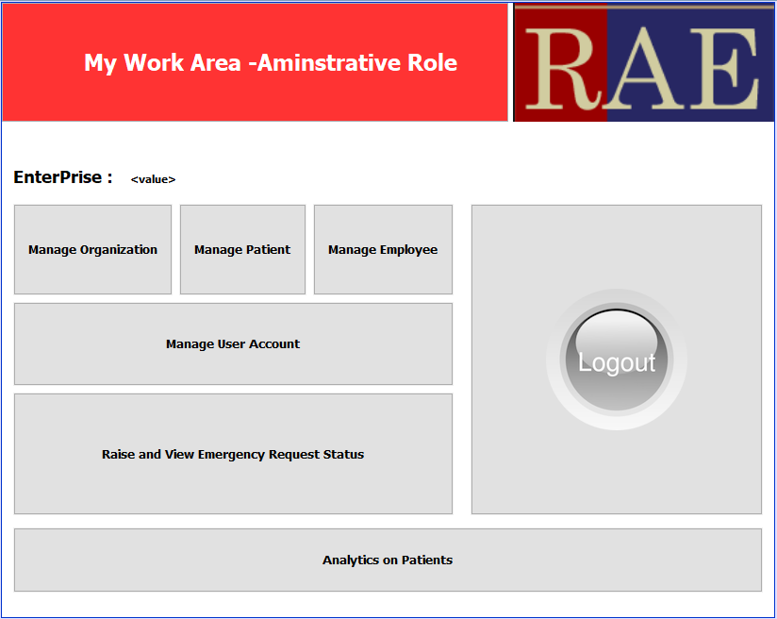
Screenshots
System Administrator

Slide 8
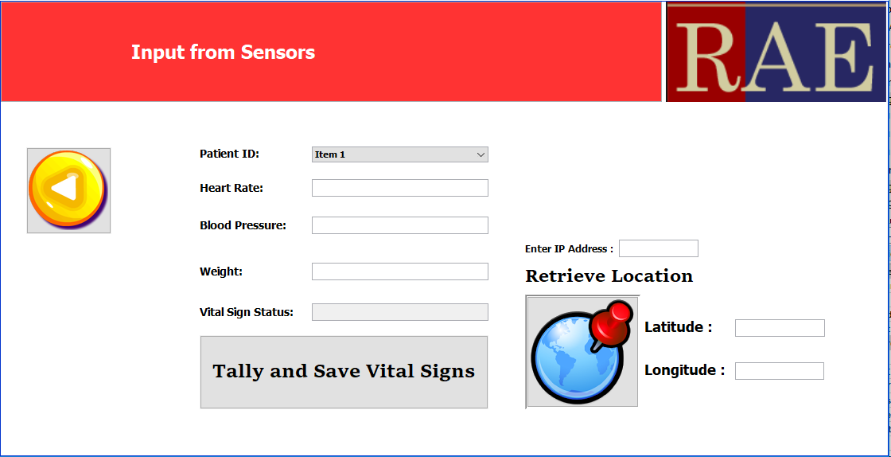
Screenshots
Vital Sign Sensor

Slide 9
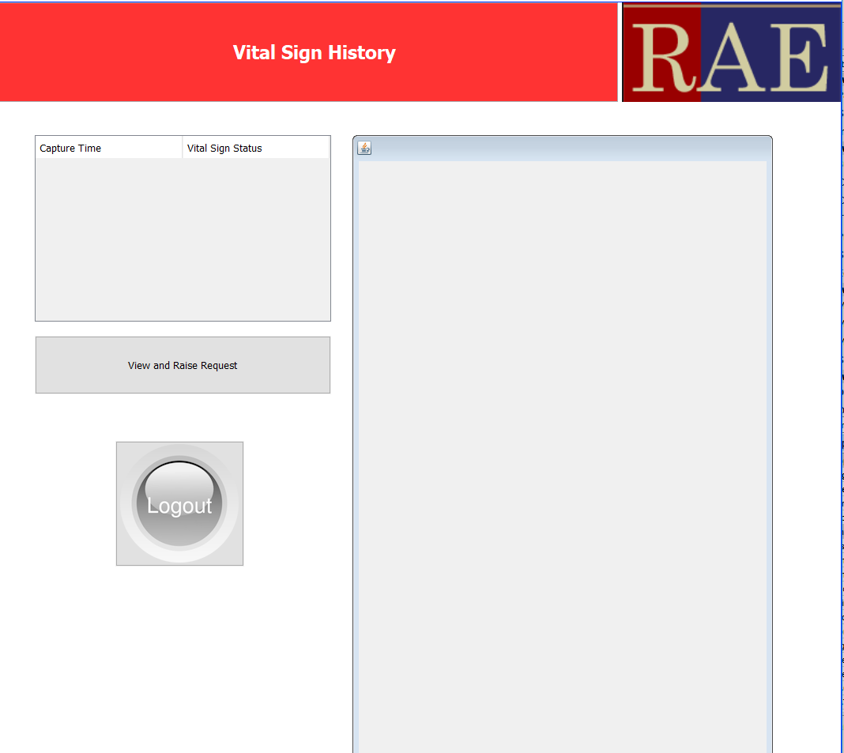
Screenshots
Vital Sign History

Slide 10
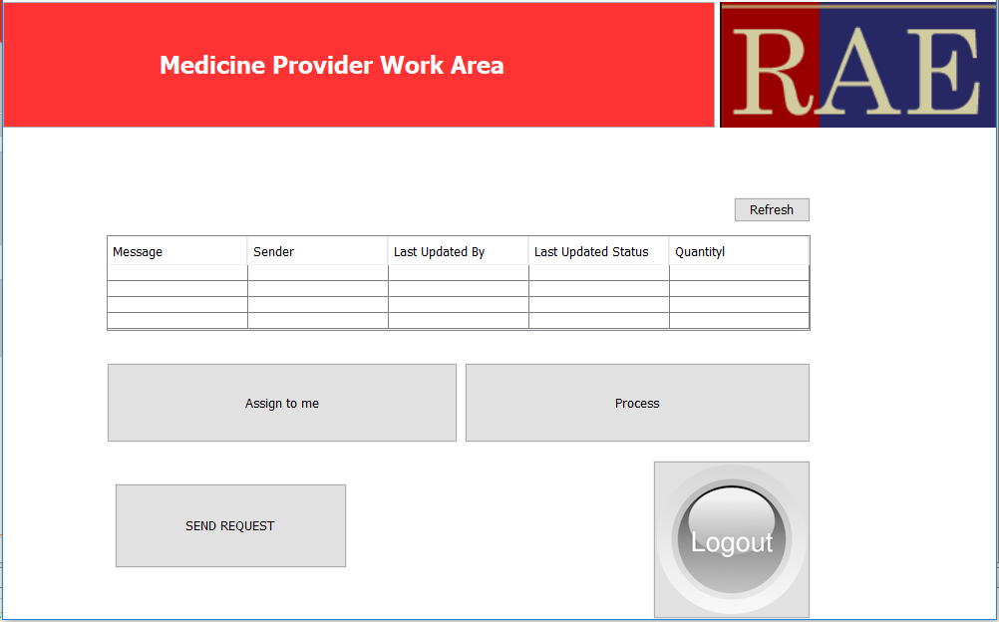
Screenshots
Medicine Provider Area

Slide 11
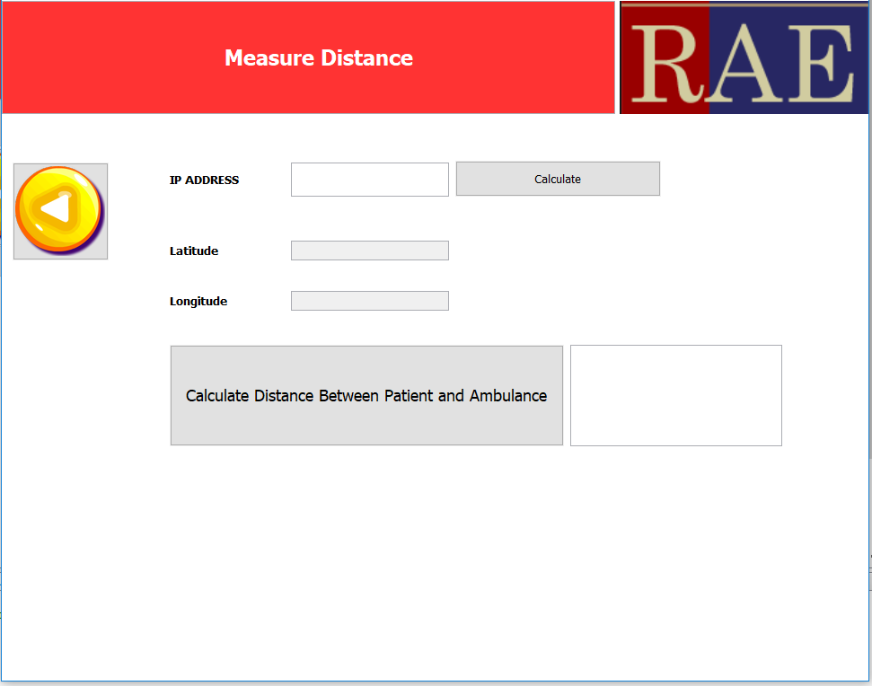
Screenshots
Distance between Ambulance and Patient

Slide 12
Thank You

